Slide 1
State of Rhode Island Disparity Study
Business Community Meeting
September 20, 2019

Slide 2
Meeting Agenda
Introduce the study team
Describe study research objectives
Describe legal standard
Outline study data requirements
Present study timeline
Receive public comment

Slide 3
Firm Profile
Established in 1978
Public policy research and marketing professionals
AWARD-WINNING COMPANY
Equity service divisions
Business affirmative action
Corporate communication

Slide 4
Mason Tillman Team
Prime Consultant | Certification
Mason Tillman Associates, Ltd. Eleanor Ramsey, Ph.D. President/Project Manager | M/WBE
Subconsultant | Certification
Regina Villa Associates, Inc. Regina Villa President | M/WBE

Slide 5
Mason Tillman Studies
STATES
15
CITIES
33
TOTAL STUDIES
144
COUNTIES
19
TRANSPORTATION AGENCIES
39
SPECIAL DISTRICTS
38

Slide 6
Mason Tillman State Studies
States Clients
State of Rhode Island
State of New York
State of Illinois
Commonwealth of Pennsylvania
State of Texas
State of New Jersey
State of Ohio
State of Indiana
State of Indiana Lottery
State of Indiana Riverboat Casinos
State of Minnesota
State of Washington
State of Missouri
State of Oregon Department of Administrative Services
State of Oregon Higher Education, Portland

Slide 7
City of Richmond v. J.A. Croson
State/Local
Federal
Adarand v. Pena
Richmond v. Croson
Compelling interest
  Evidence of systemic racial discrimination
Narrowly tailored
  Remedy documented discrimination
Update periodically
  Assess effectiveness of remedy

Slide 8
City of Richmond v. J.A. Croson
The Facts:
14th Amendment Equal Protection Challenge to City MBE Contracting Program
City adopted a Minority Business Utilization Plan
30% Subcontracting Set Aside for Minority Business Enterprises

Slide 9

Scope of Croson’s Application
14th Amendment Equal Protection Clause:
Race and Ethnicity
  A business owned 51% by a member of a minority group
  Minority Group members are defined as citizens of the United States who are Black, Spanish speaking, Oriental, Indians, Eskimos or Aleuts
Gender and Sexual Orientation
  Gender and sexual orientation addressed in the 14th Amendment Equal Protection standard applied in Croson

Slide 10
Croson Study Objectives
Define relevant market area
Determine if statistical disparity exists
Ascertain practices affecting any documented disparity
Assess effectiveness of race- and gender-neutral programs
Draft detailed program recommendations
Prepare a legally defensible study

Slide 11
Narrowly Tailored Remedy
Disparity findings are race, gender, and industry-specific
Subcontract goals limited to ethnic and gender groups in industries with disparity findings
Goals defined by availability of the ethnicity and gender groups with disparity in each industry

Slide 12
Study Parameters
Study Period:
July 1, 2014 to June 30, 2017
Construction
Services (including professional services)
Goods/
Commodities/
Supplies
Construction-related Services

Slide 13
Consortium Members
Participants
State of Rhode Island
The University of Rhode Island
Rhode Island College
Community College of Rhode Island

Slide 14
Utilization
Contracts awarded during the study period
  Prime contracts
    State extracts data
    Mason Tillman cleans and organizes data
      Assigns industry to each contract
      Determines business owner ethnicity and gender
  Subcontracts
    State extracts data
    Mason Tillman conducts research to reconstruct complete subcontract data
  Market Area
    Mason Tillman determines geographic market area where State awards its contracts

Slide 15
Availability
Willing and able businesses enumerated from government and non-government sources
Businesses identified from non-government sources surveyed:
  Willingness to contract with the State
    Collect race, gender and industry information
  Capacity to perform on State contracts
    Collect bidding history, revenue, number of employees, owner education, etc.
      Available businesses classified by ethnicity, gender, and industry

Slide 16
Anecdotal
Oral accounts elicited from 40 business owner interviews
Evidence compiled from e-survey with all available businesses
Qualitative evidence analyzed for contracting patterns and practices in market area
Analysis used to inform the race and gender-neutral recommendations

Slide 17
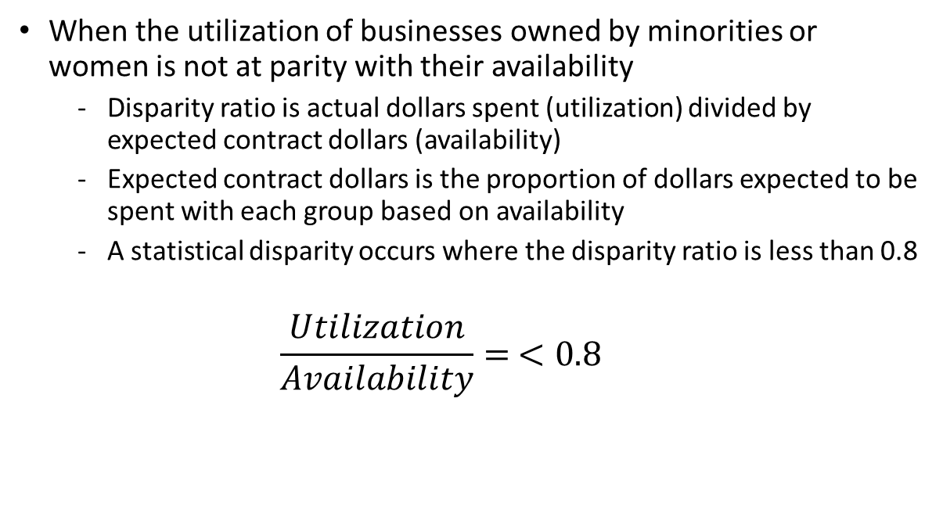
Disparity
When the utilization of businesses owned by minorities or women is not at parity with their availability
  Disparity ratio is actual dollars spent (utilization) divided by expected contract dollars (availability)
  Expected contract dollars is the proportion of dollars expected to be spent with each group based on availability
  A statistical disparity occurs where the disparity ratio is less than 0.8
  $$\frac{Utilization}{Availability}= <0.8$$

Slide 18
Barriers by Government
Bid information difficult to obtain
Prime contracts bundled and multi-year
Inadequate lead time to bid
Excessive monitoring
Late payments to prime contractors
Absence of standardized procurement process

Slide 19
Barriers by Prime Contractors
Bids shopped after award
Scope of work reduced
Unauthorized substitution
Disparate performance standards
Late payments to subcontractors
Uncompensated change orders
Insufficient mobilization notice

Slide 20
State Contracting Opportunities
State | East Providence High School
Carole Cornelison Division Director Department of Administration carole.cornelison@doa.ri.gov | Carlos Neves Gilbane Building Company cneves@gilbaneco.com

Slide 21
Partner With Us
Complete the business survey
Agree to an anecdotal interview
Email | RhodeIslandStudy@mtaltd.com
Business Survey | https://www.tfaforms.com/4758045
Mail | Mason Tillman Associates, Ltd. 1999 Harrison Street Suite 2000 Oakland, CA 94612
Call | (401) 633-7505

Slide 22
Public Comment

Slide 23
Please State
Your name
Business name
Organizational affiliation
  Limit responses to two (2) minutes
  Return comment card to Mason Tillman staff

Slide 24
감사합니다!
cảm ơn!
THANK YOU
Merci!
Cпасибо!
¡Gracias!

